Slide 1
CallFire API
Introduction

Slide 2
Outline
Overview
Generating API credentials
7 Services
CallFire API information
REST API
REST Example SendText
SOAP API
SOAP Example SendText PHP

Slide 3
Overview
7 services: broadcast, subscription, text, call, contact, number, and label.
Need separate API credentials (see Add API Access). Callfire username and password won’t work.
REST and SOAP APIs functionally equivalent since they use same underlying services.
REST documentation includes ability to execute operations in browser using “Try me!” button.
REST supports both JSON and XML encoding.
SOAP documentation includes PHP code examples.

Slide 4
API Credentials
API credentials are NOT the same as website credentials. Different username and password.
Create API credentials on www.callfire.com/ui/manage/access
See following slides for screen shots.
Select “Settings” view.
Select “API Access” tab in “Settings” view.
Press “Add API Access” and fill in form.
Remember to write down password.

Slide 5
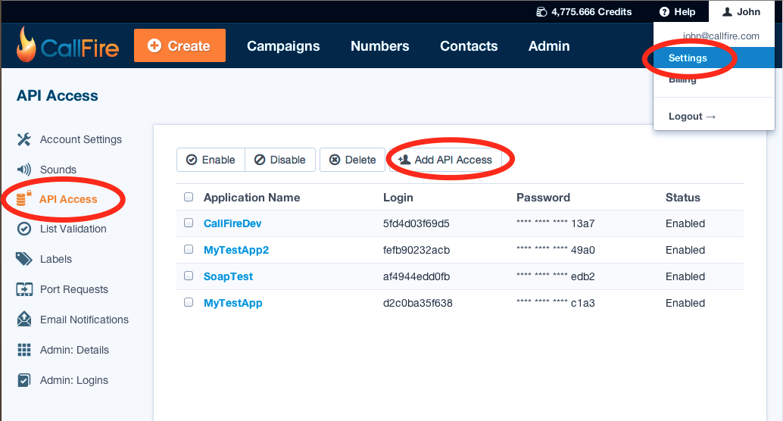

Slide 6
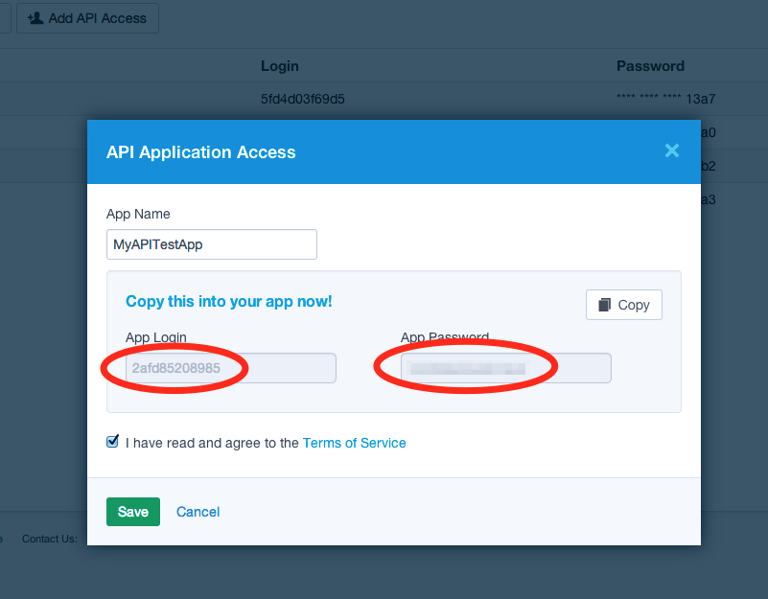

Slide 7
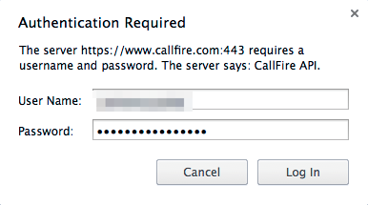
Browser API Credentials Request

Slide 8
7 Services
http://callfire.com/api/1.1/wsdl/callfire-service-http-soap12.wsdl
Broadcast - Creating and managing outbound call and texts.
  Prefer Text or Call service for simple cases.
Subscription - Creating and managing subscriptions (callback notifications), which listen for account events.
Text - Sending and receiving text messages and managing auto-replies.
Call - Sending calls, viewing their results, and managing sound files.
Contact - Manage contact lists.
Number - Buying and configuring numbers and keywords.
Label - Labeling and querying objects by label.

Slide 9
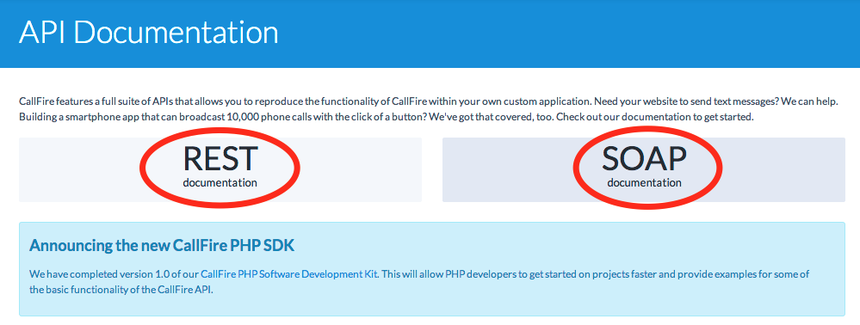
CallFire API Documentation
http://www.callfire.com/api-documentation

Slide 10
REST Documentation
https://www.callfire.com/api-documentation/rest/version/1.1
Execute REST API calls through documentation page.
  “Try Me!” button on bottom.
  Browser will request API credentials.
XML encoding by default. Use JSON encoding by appending .json to resource uri (.../rest/text.json).
Side panel offers SOAP service names to show operation mapping (SendText -> POST /text).
Form encoding for POST (see POST /contact/list).

Slide 11
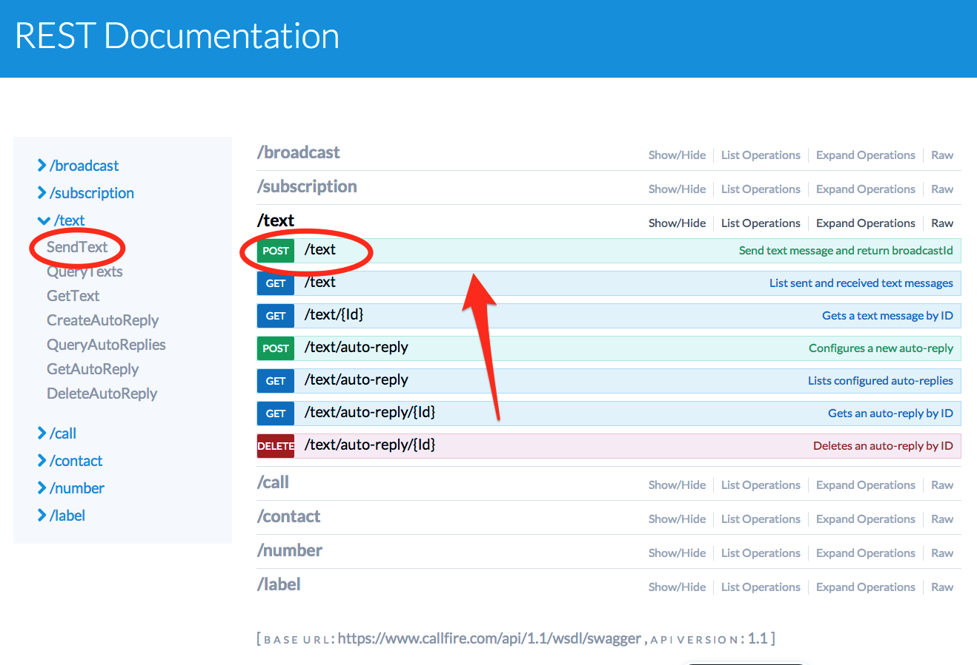

Slide 12
SendText REST Example
Goto POST /text REST documentation.
  https://www.callfire.com/api-documentation/rest/version/1.1#!/text/SendText_post_0
Mandatory parameters - Type, To, and Message.
Fill in parameters - Type = ‘Text’, To = ‘1310… 1213….’, Message = ‘Test sending SMS message’.
Hit “Try it out!” at bottom.
Returned XML is a ‘ResourceReference’ which includes ‘Id’ (BroadcastId) and ‘Location’ (resource uri) to retrieve referenced broadcast from.

Slide 13
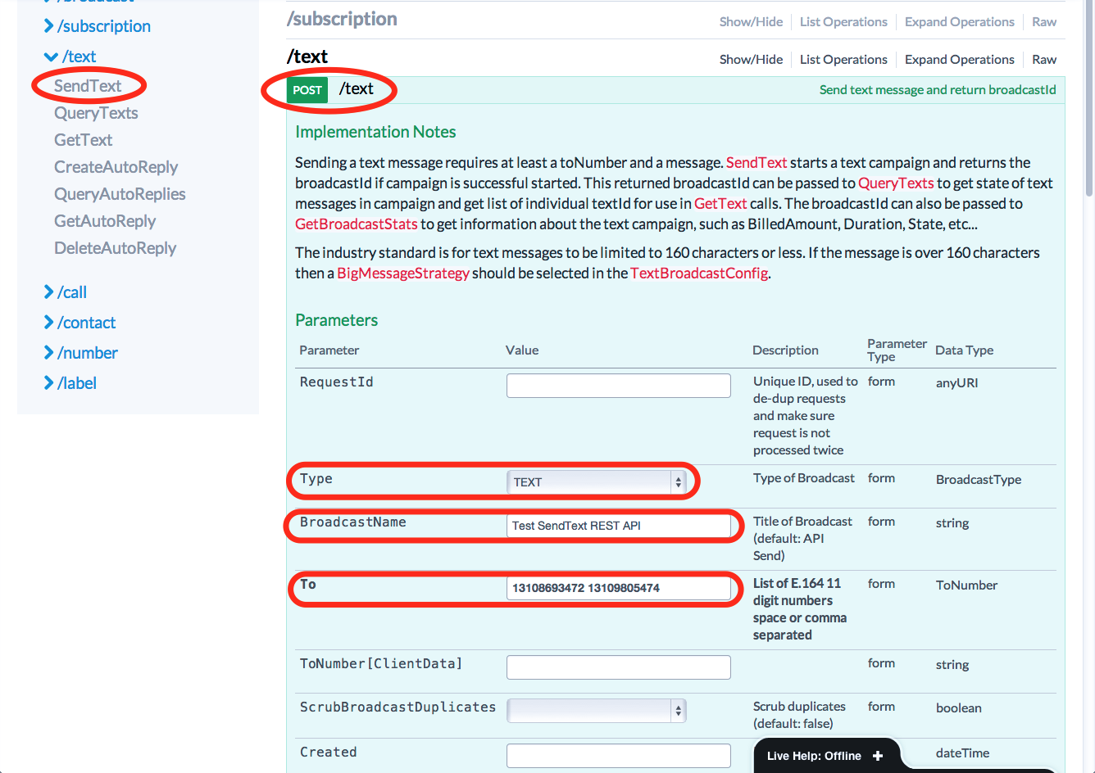

Slide 14
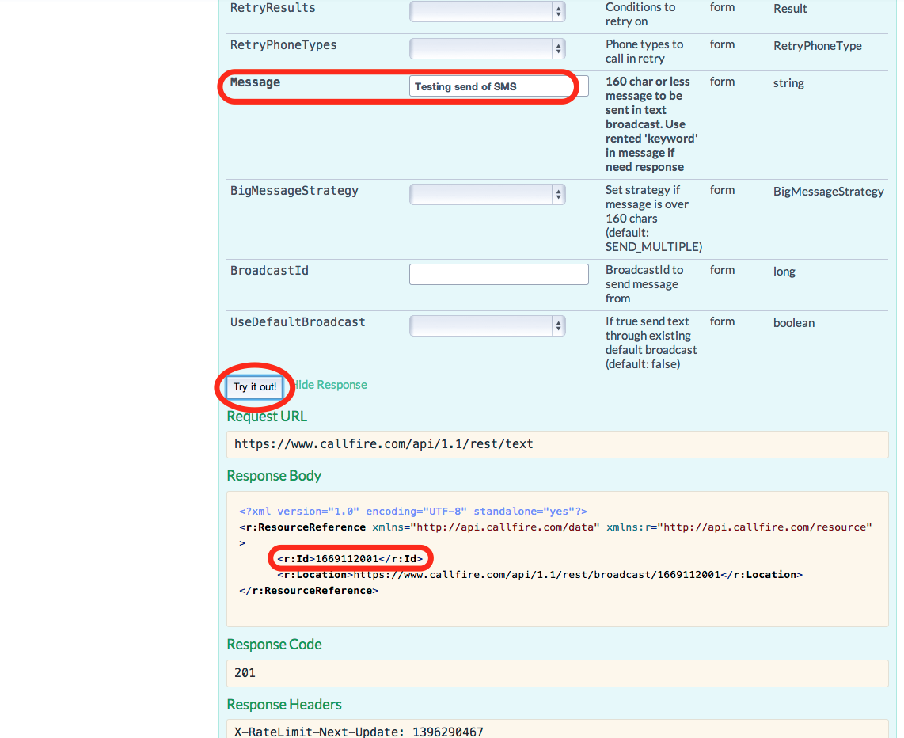

Slide 15
SOAP Documentation
www.callfire.com/api-documentation/version/1.1
WSDL - www.callfire.com/api/1.1/wsdl/callfire-service-http-soap12.wsdl
PHP examples provided for each SOAP call.
  www.callfire.com/api-documentation/version/1.1/TextService/SendText
PHP Soap SDK with more complex examples.
  github.com/CallFire/CallFire-PHP-SDK

Slide 16
SendText SOAP PHP Example
Find SendText in SOAP documentation.
  www.callfire.com/api-documentation/version/1.1/TextService/SendText
Mandatory parameters - ToNumber and Message.
Copy PHP code in documentation to .php file.
  First SendText creates new broadcast.
  Second SendText uses existing broadcast.
Execute using ‘php <filename>.php’.
Should echo ‘broadcastId: <new broadcastId>’
Should receive text message on ToNumbers.

Slide 17
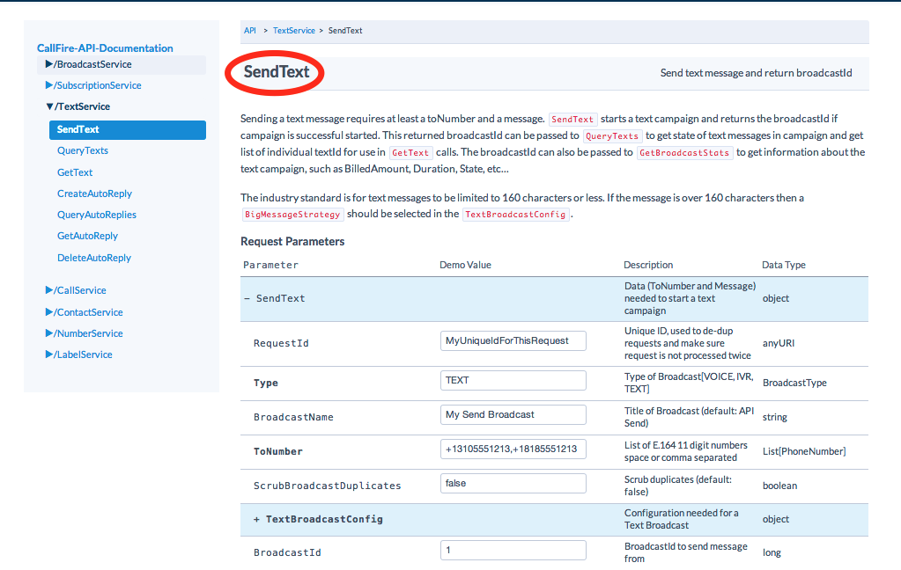

Slide 18
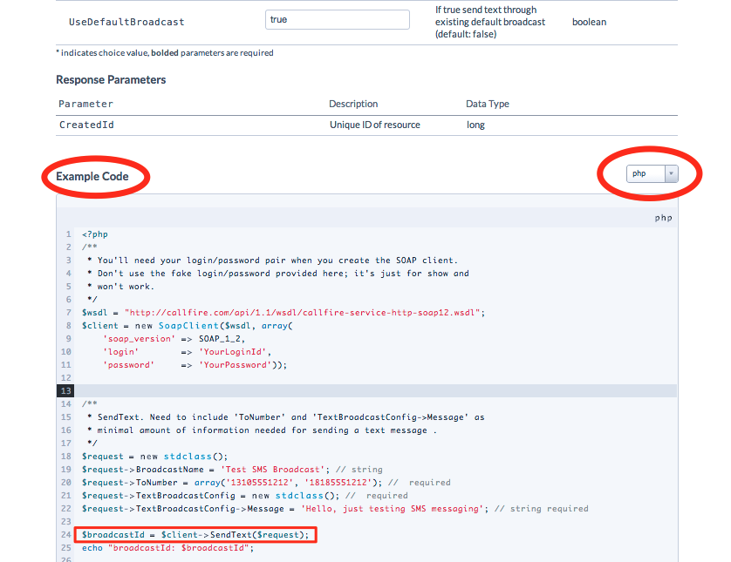

Slide 19
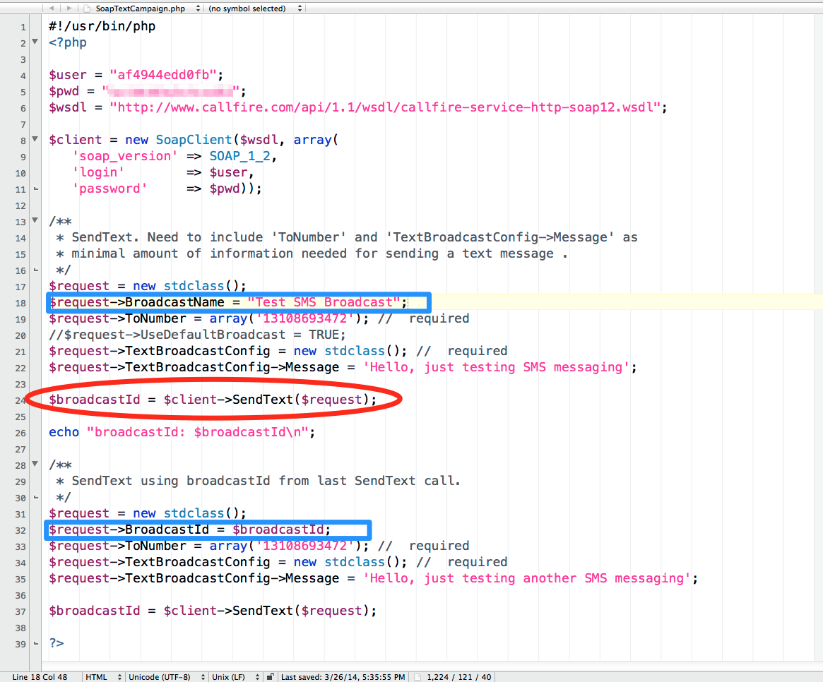

Slide 20
Next Steps
Webinar “Managing a Text Campaign”.
  Get results.
  Set up notifications with Subscription API.
  Manage contacts.

